Slide 1
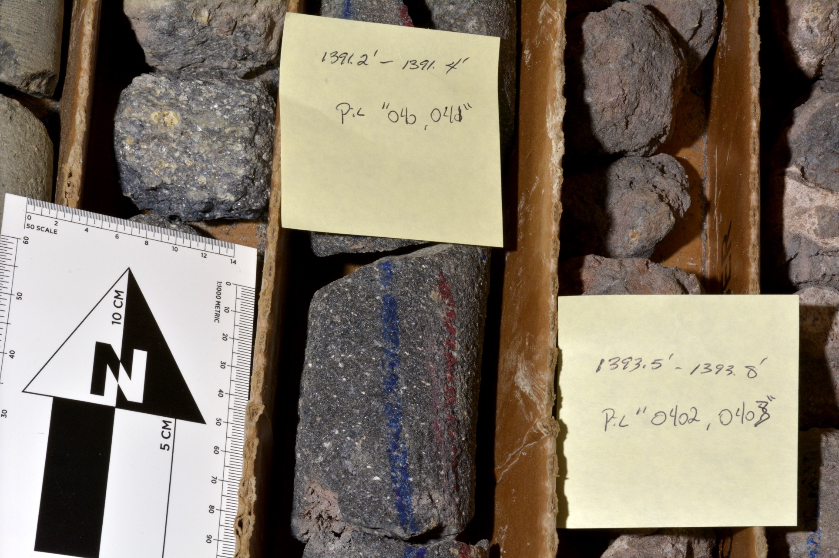
Notes:
From upper perlitized vitrophyre of USGS 142 rhyolite unit. Tags are to the right of collected samples. Right side of core tray illustrates some intra-deposit auto-brecciation.
(Photo: Hackett)

Slide 2
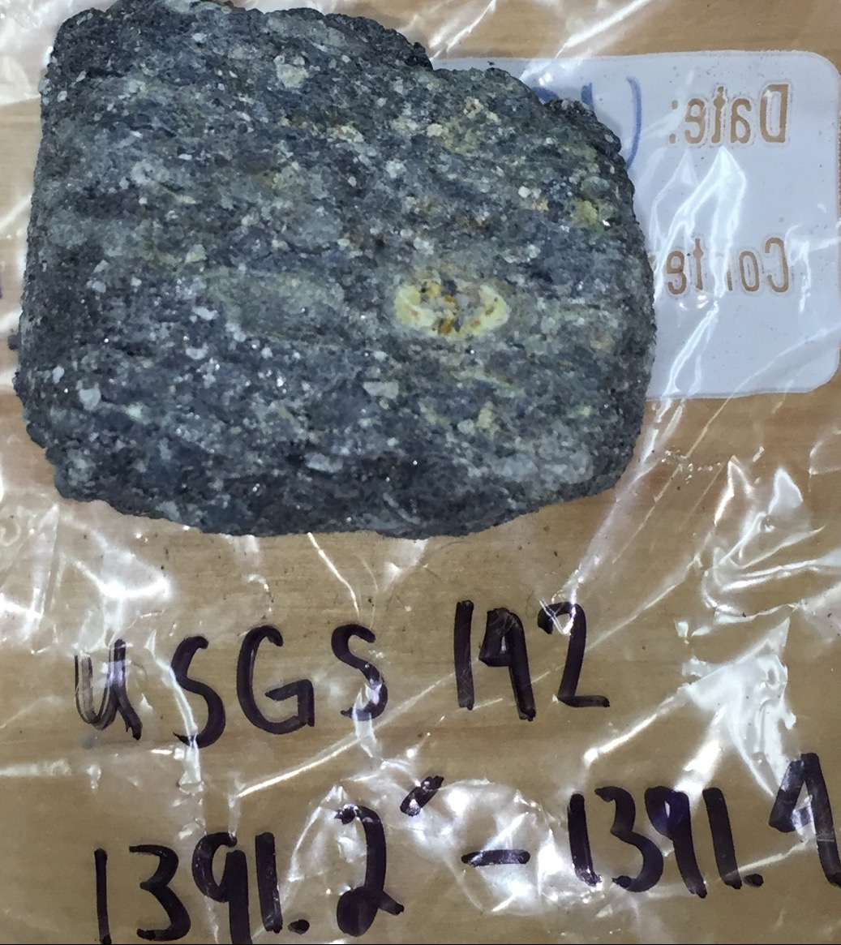
Notes:
From upper perlitized vitrophyre of USGS 142 rhyolite unit. Note relatively abundant light-colored to ghost-like lithics (to 1 cm across), relatively abundant plag phenocrysts (~7-10%). A possible fines-depleated ignimbrite facies.
(Photo: McCurry)

Slide 3
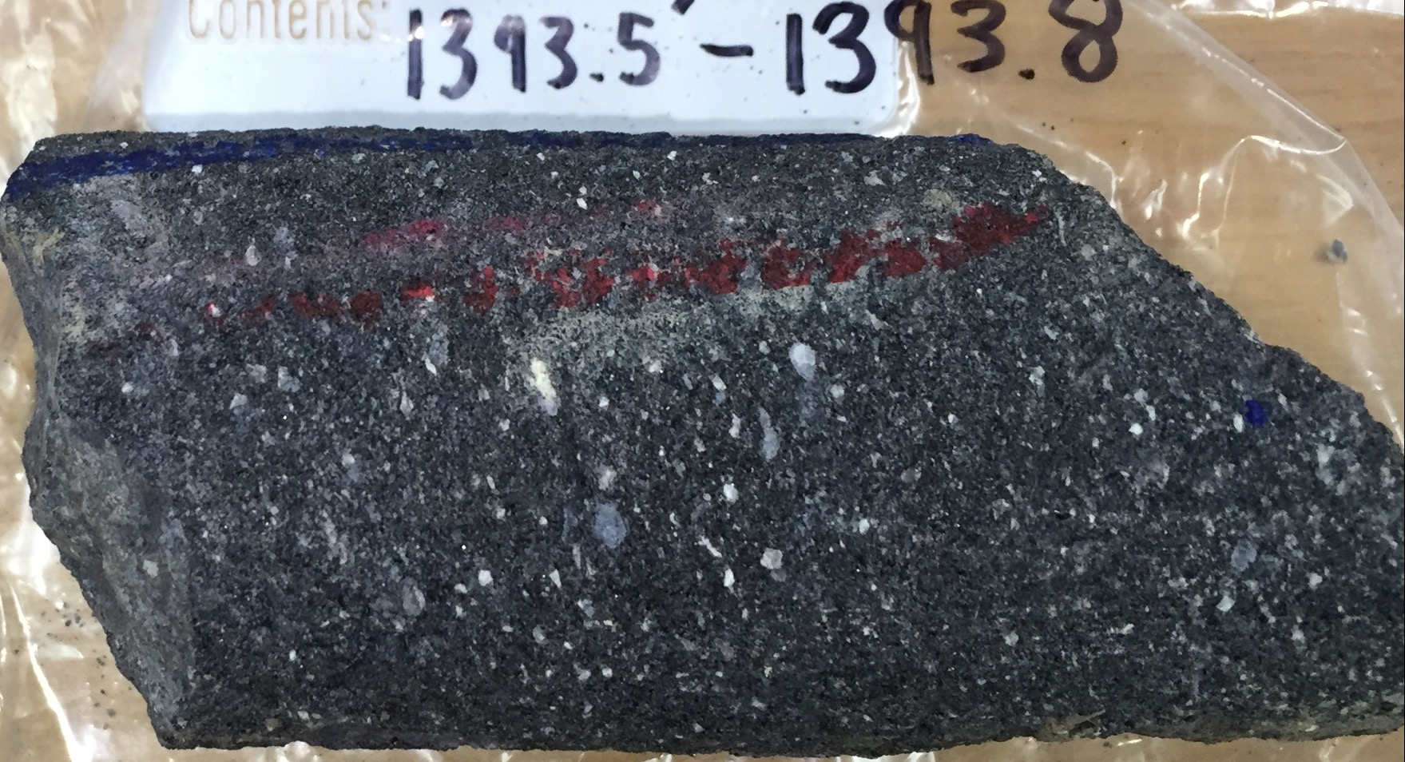
Notes:
Dense black plag phyric vitrophyre. ~10% black (chippy’) lithics to several mm
(Photo: McCurry)

Slide 4
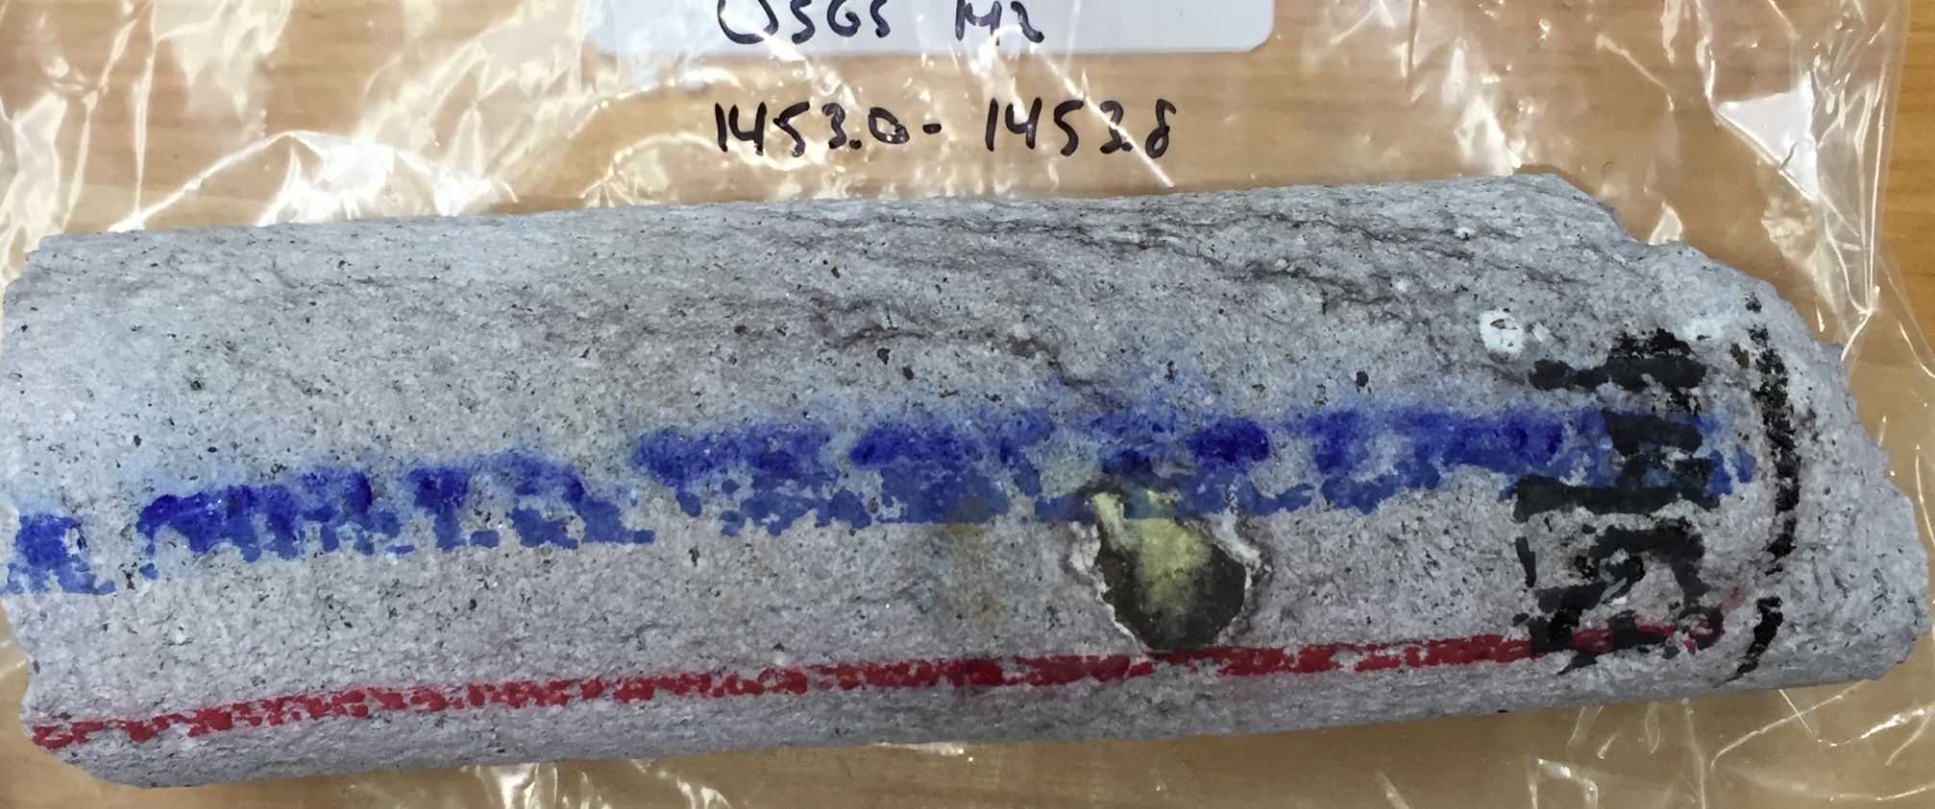
Notes:
Crystalline/devitrified/vapor-phase flow banded, plag phyric crystallized rhyolite. NOTES: 1. prominent dark-colored fg lithc clast ~2 cm across; 2. near-vertical (flow) banding
(Photo: McCurry)

Slide 5
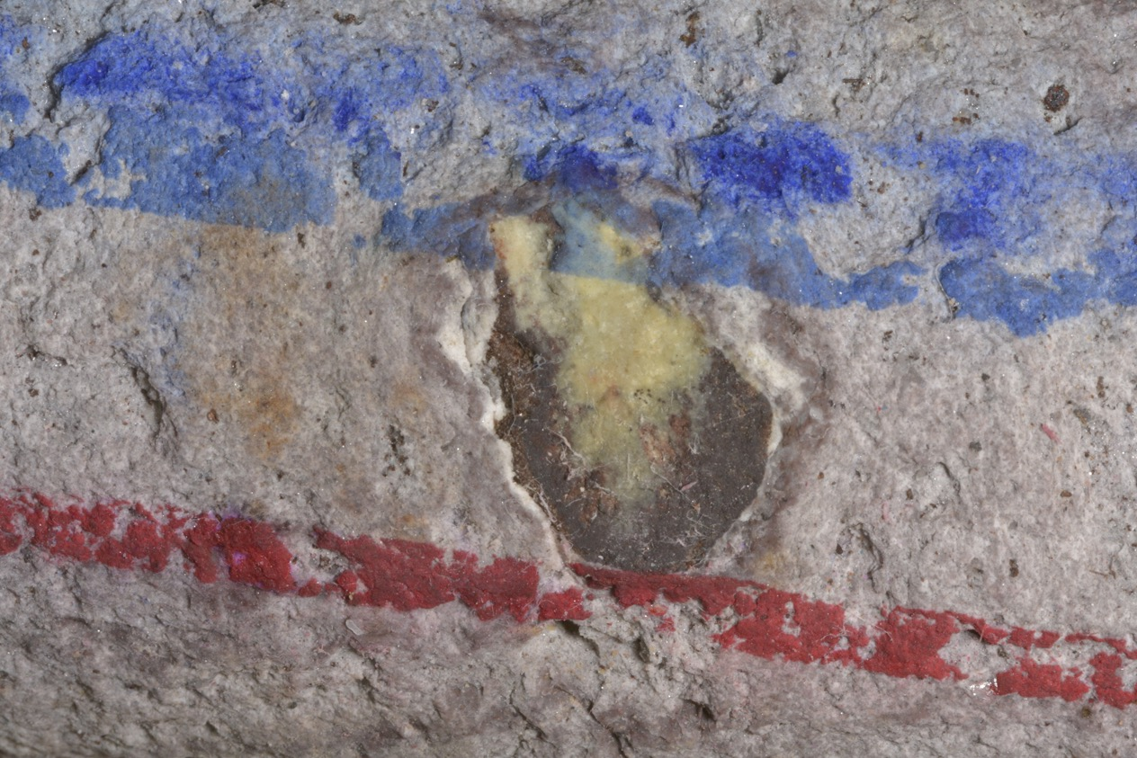
Notes:
Close up of lithic in previous pholto (1452 feet).
(Photo: Hackett)

Slide 6
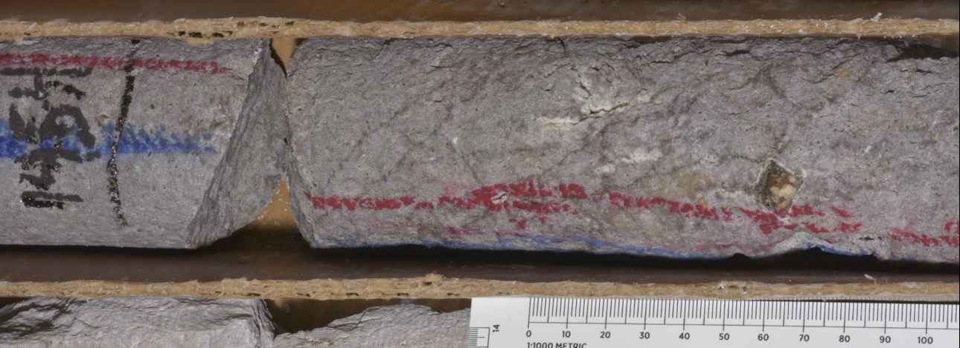
Notes:
Prominent lithic ~1 cm across near 1454 feet (above the ruler between 60 and 70).
(Photo: Hackett)

Slide 7
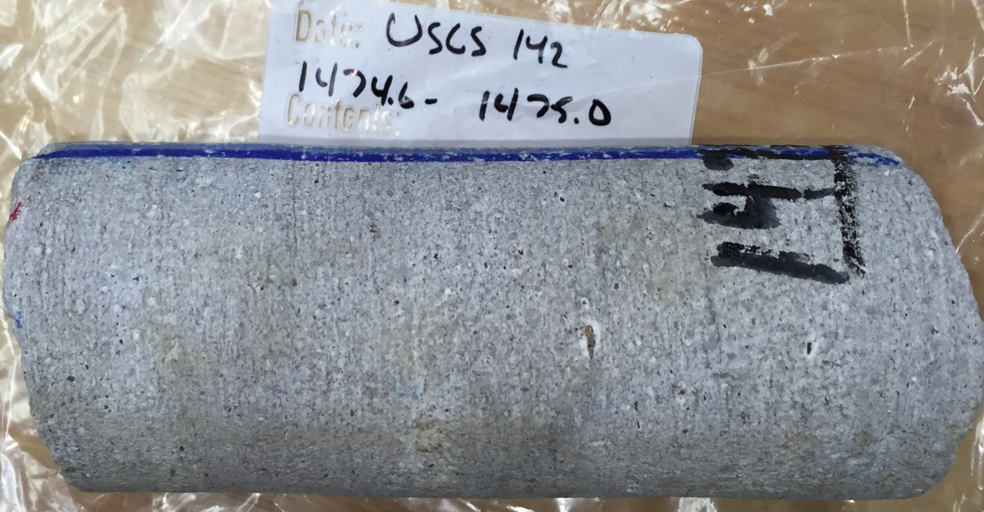
Notes:
Light grey, subhorizontally folliated plag phyric rhyolite.
(Photo: McCurry)

Slide 8
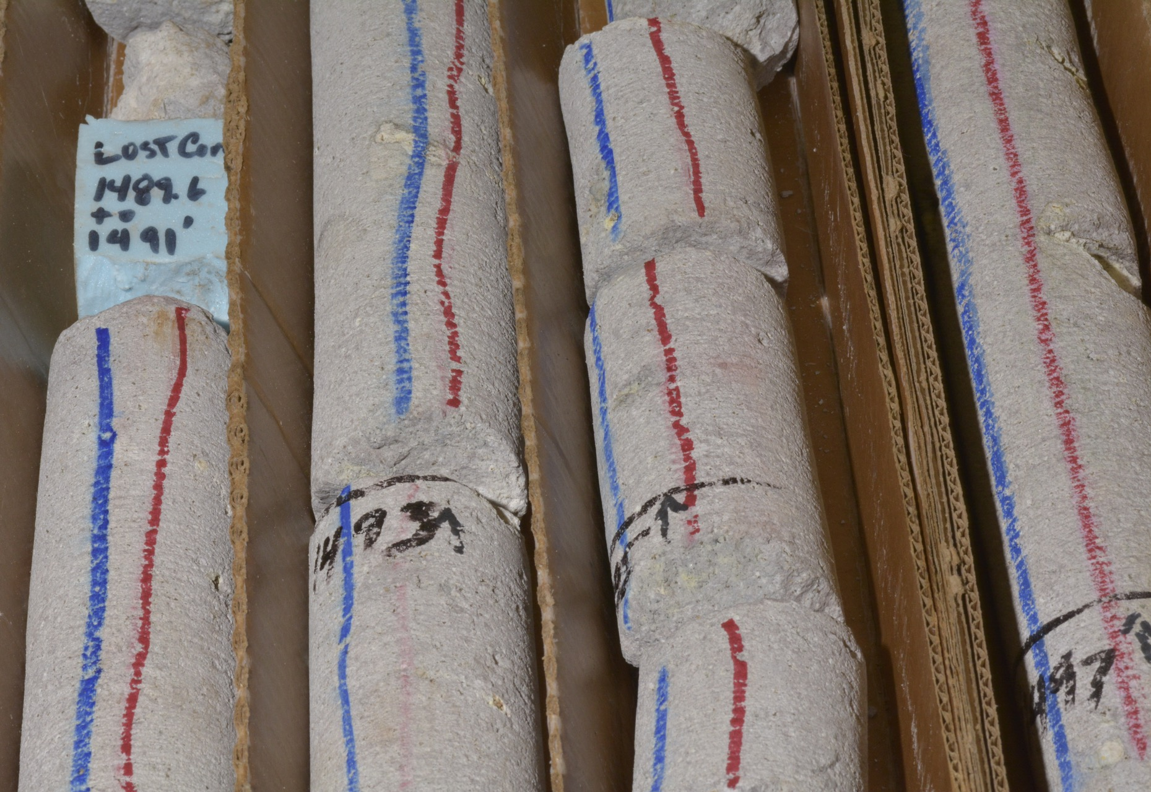
Notes:
Light grey, weakly subhorizontally layered/foliated plag phyric rhyolite; scattered lithophsal cavities.
(Photo: Hackett)

Slide 9
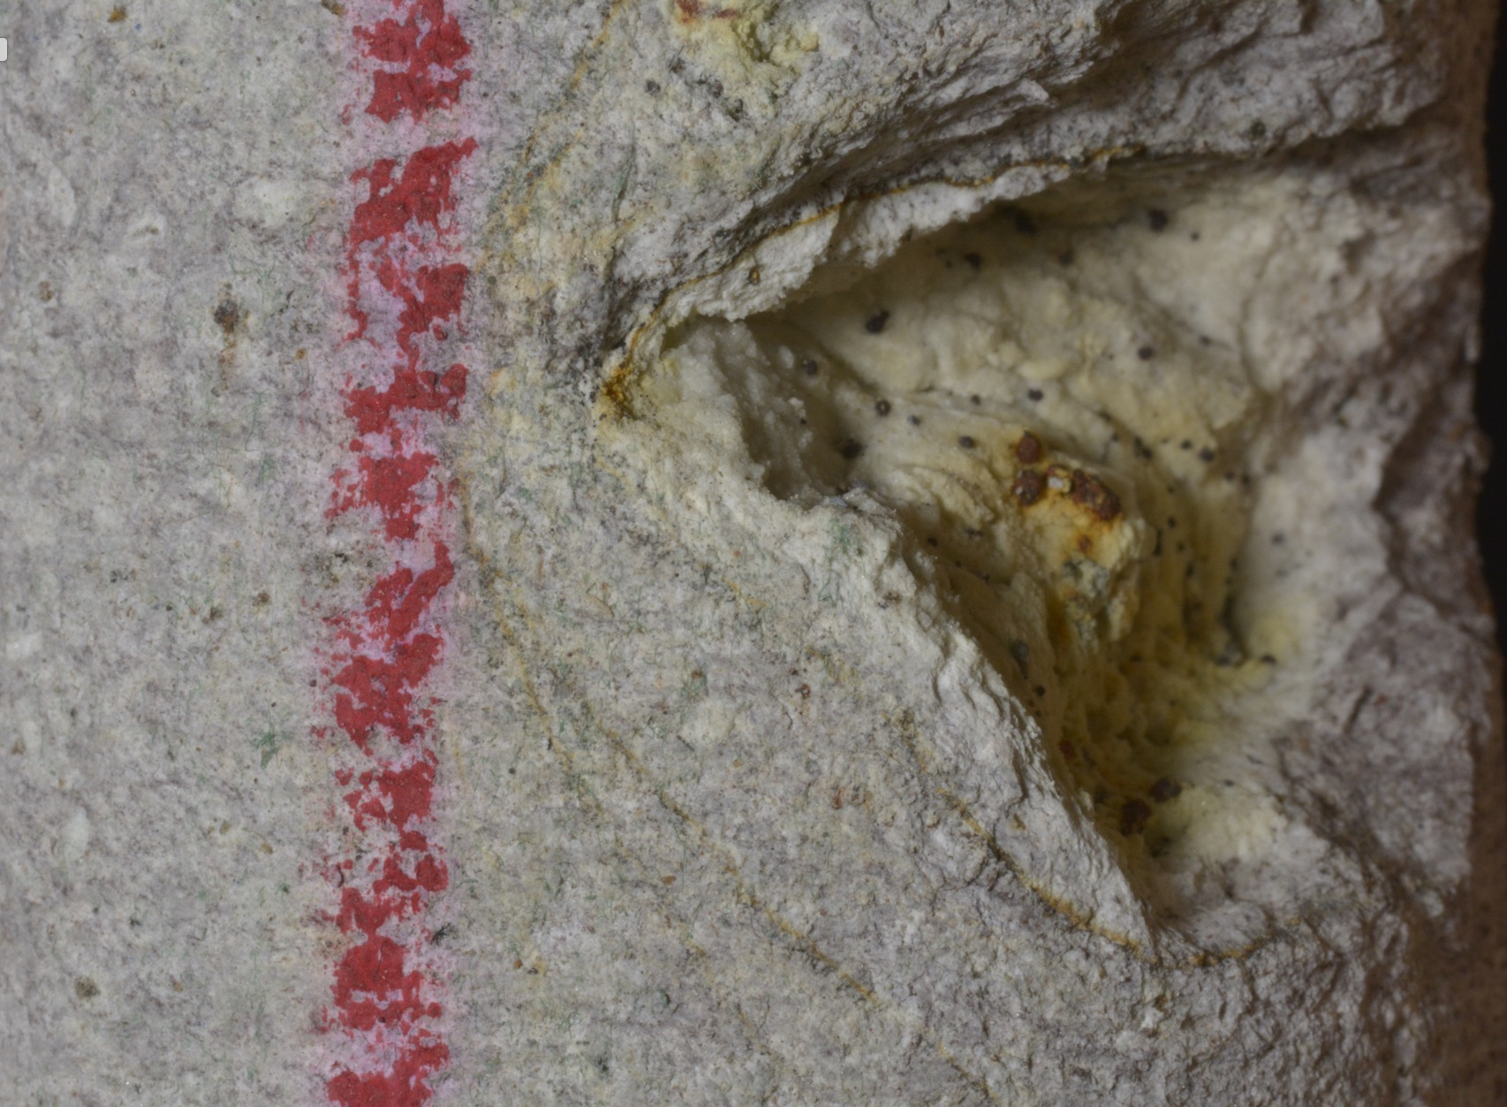
Notes:
Close-up of lithophysal cavities (lined by fg vapor-phase minerals(?)). Note deformed foliation around cavity.
(Photo: Hackett)

Slide 10
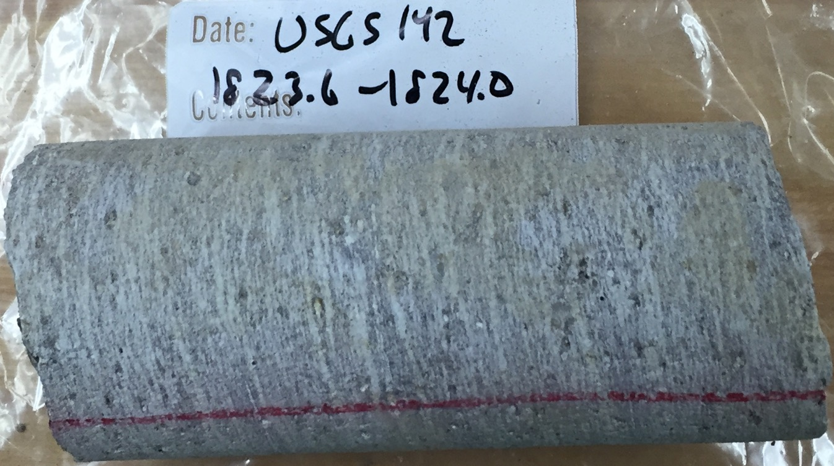
Notes:
Light grey, to pinkish grey subhorizontally folliated plag phyric rhyolite. Wispy, branching layering.
(Photo: McCurry)

Slide 11
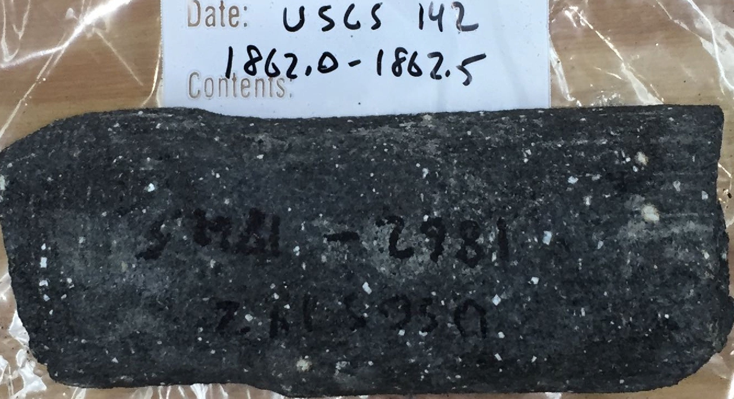
Notes:
Dense black plag phyric vitrophyre. Blocky white plagioclase phenocrysts up to ~2 mm; lithics up to 4 mm.
(Photo: McCurry)

Slide 12
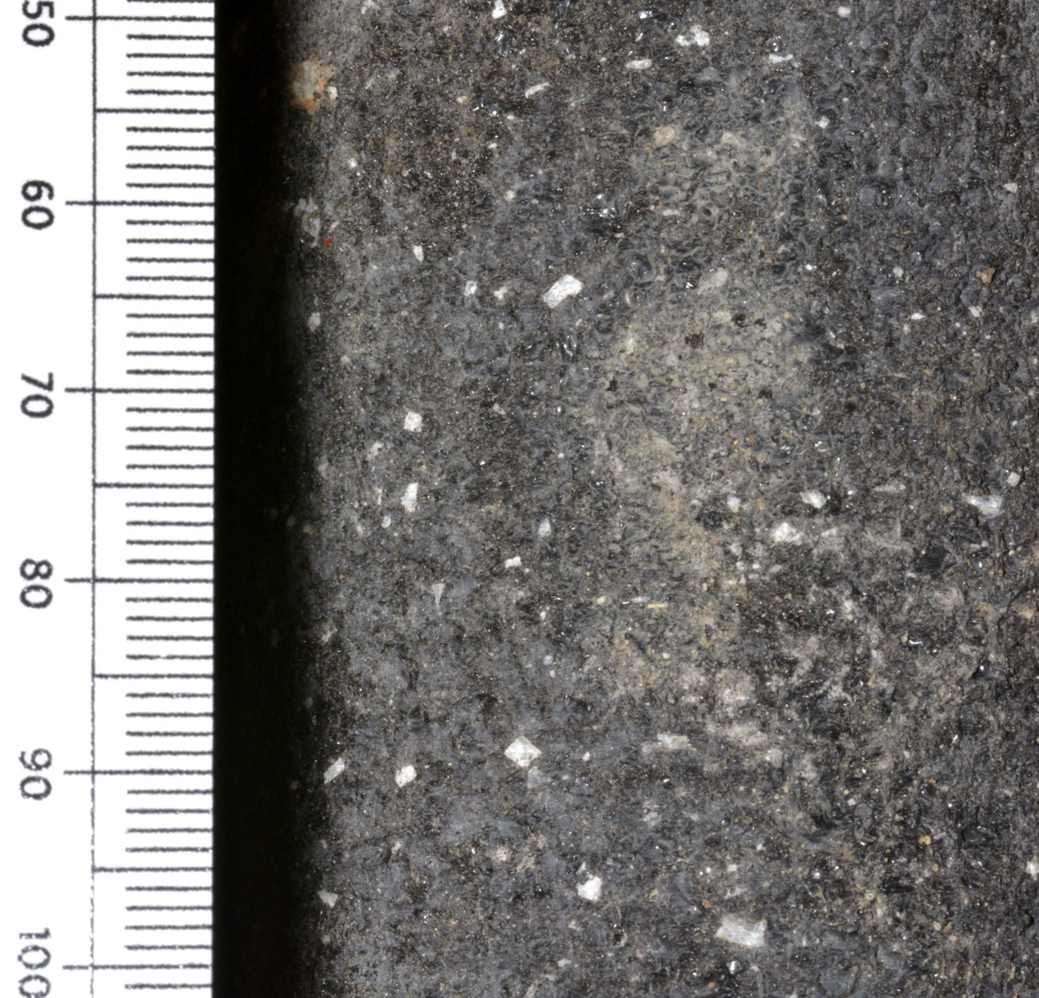
Notes:
Dense black plag phyric vitrophyre. Blocky white plagioclase phenocrysts up to ~2 mm; lithics up to 4 mm. Close up of 1862 (shown in previous PPT photo)
(Photo: Hackett)

Slide 13
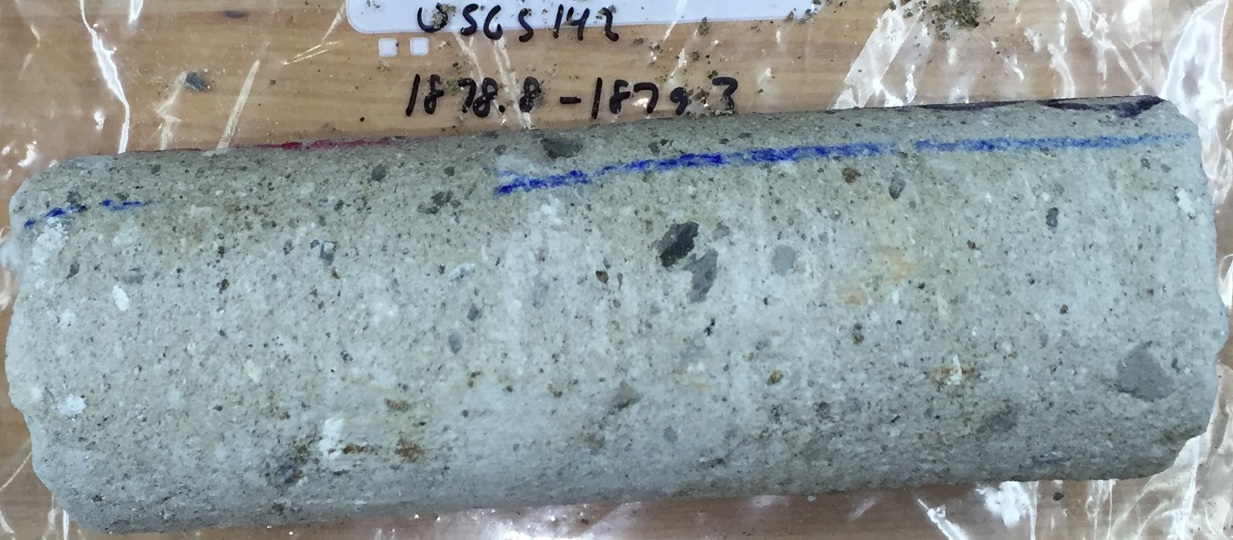
Notes:
Medium grey (turning light grey as it dries out) matrix supported volcanic breccia. Dark grey to white lithics up to 2 cm
(Photo: McCurry)

Slide 14
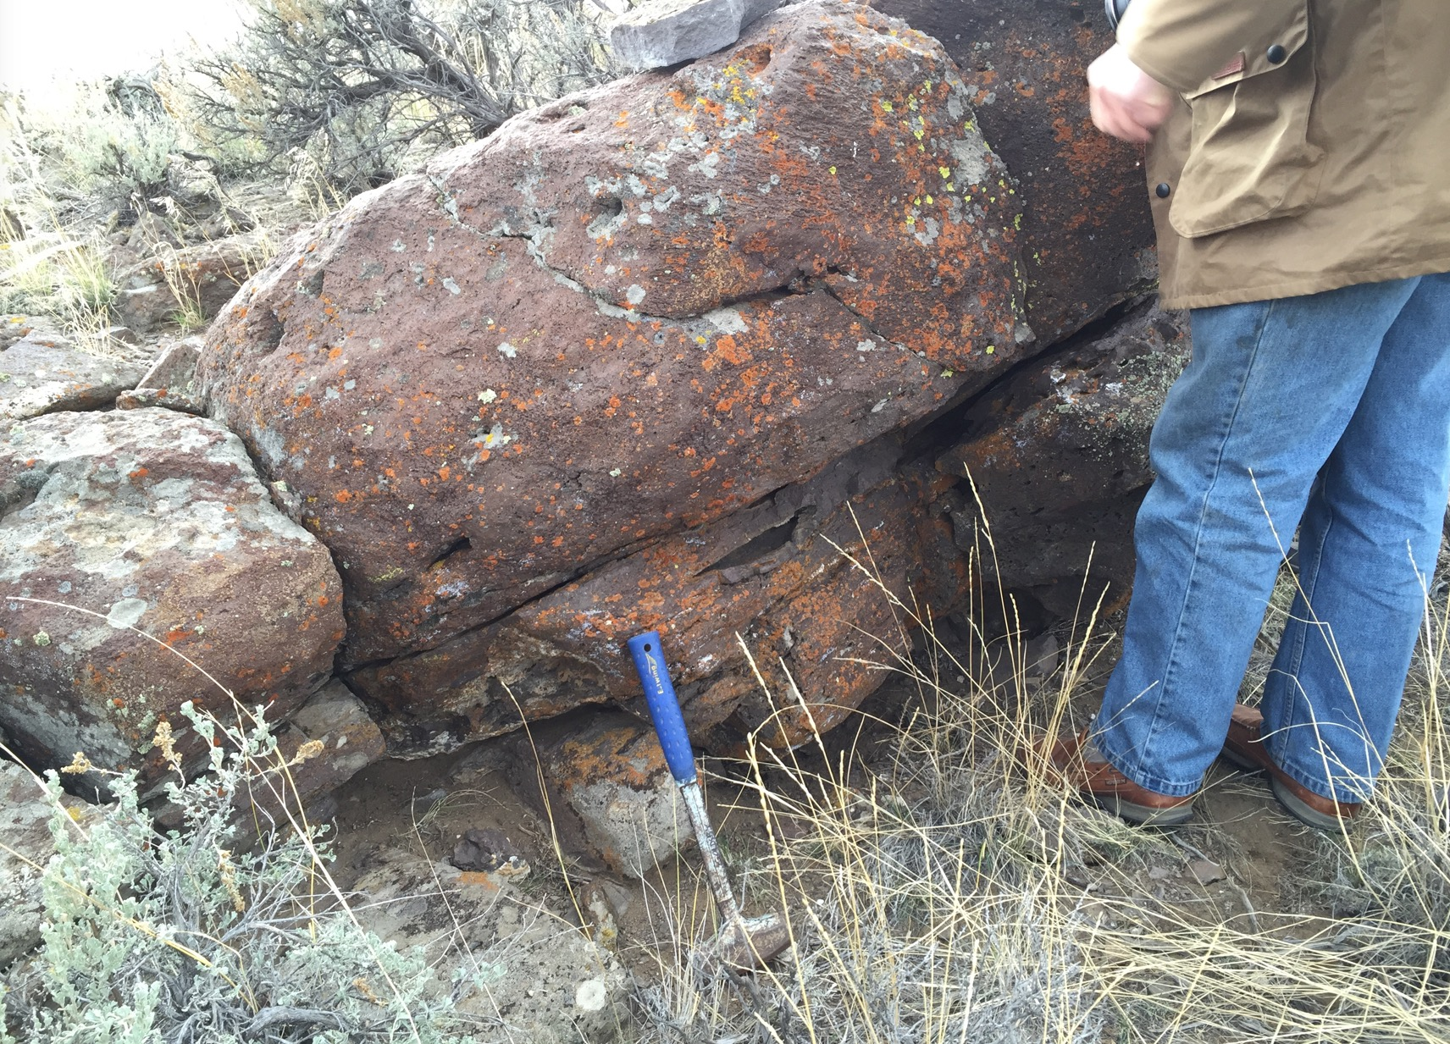
Notes:
Butte Quarry ignimbrite. North 43 deg 36' 16.38”; West 113 deg 12' 36.85”. Outcrop illustrates cryptic intra-ignimbrite layering and foliation.
(Photo: McCurry)

Slide 15
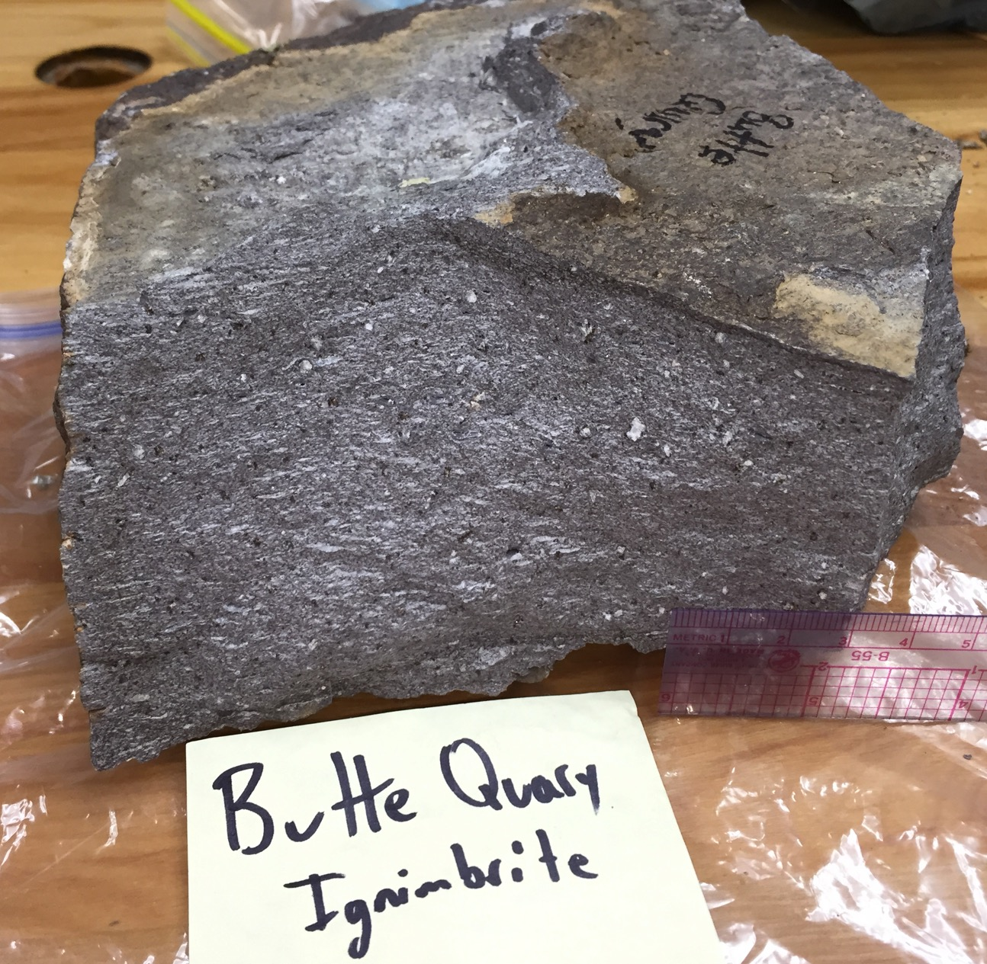
Notes:
Upper crystalline/devitrified zone.
(Photo: McCurry)

Slide 16
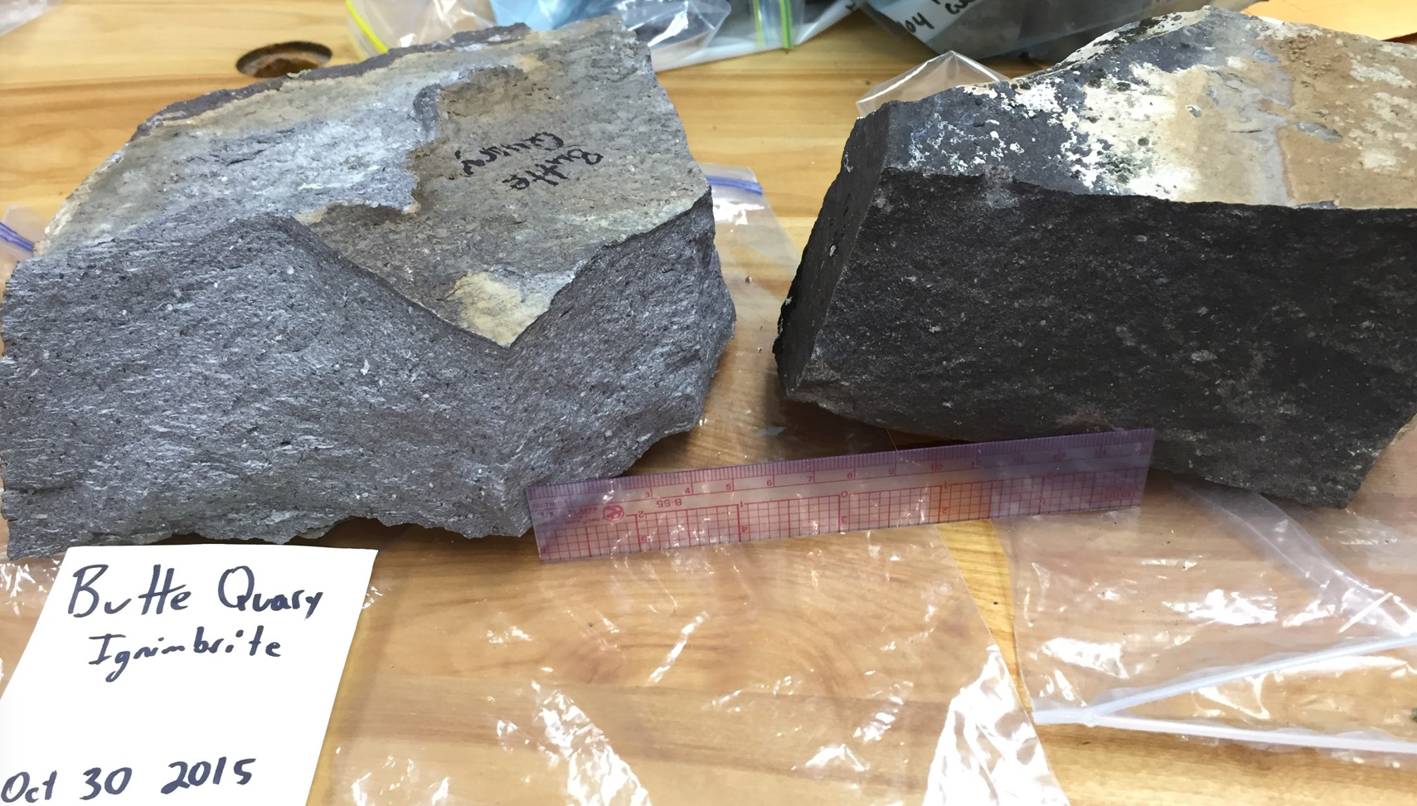
Notes:
Left: upper crystalline/devitrified zone; right: lower (stratigraphically) vitrophyre zone
(Photo: McCurry)

